Slide 1
Root Cause Analysis

Slide 2
Introduction
Objective
Identify the root cause of IOT device failure using sensor data
Predict remaining uselife(RUL) of devices before it fails

Slide 3
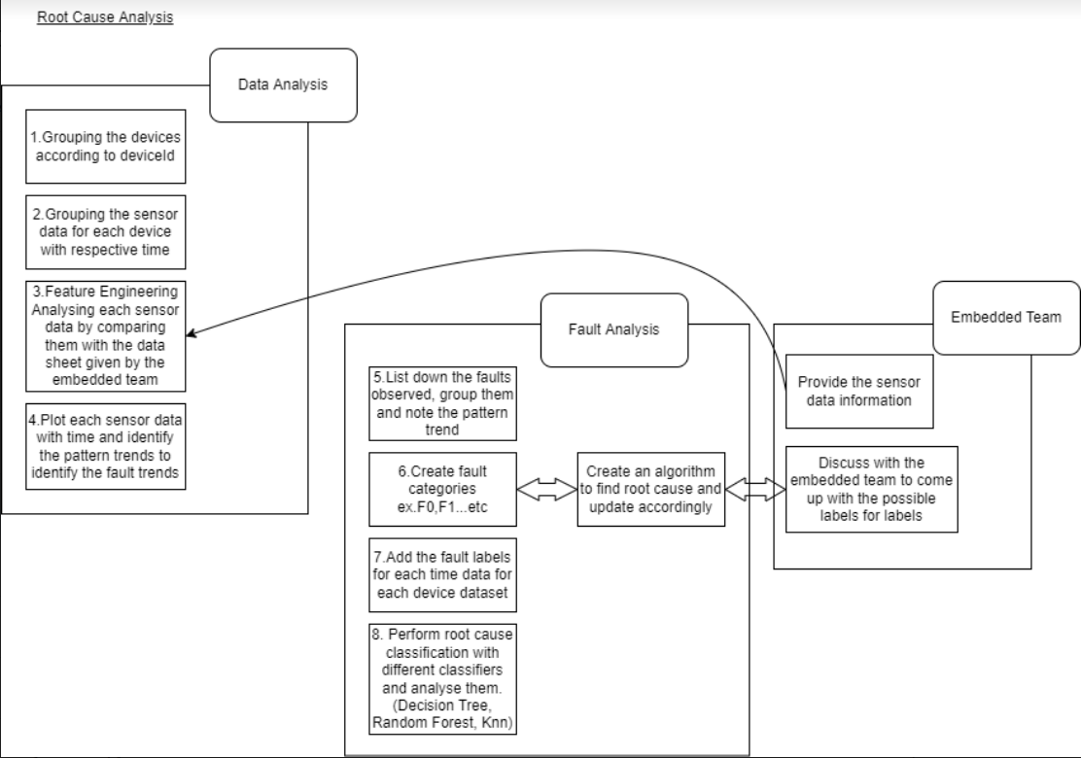
Overview

Slide 4
Current Status
Completed tasks:
Data pre-processing and Data Analysis
Fault Analysis
Fault trend analysis
Identify NULL data points, wrong data points and varying data points by comparing with the datasheet provided by the embedded team.
Identify variation data points(High,Low,Same,Normal) by using time windowing method.
Created CSV files (faults) for each devices for fault classification.

Slide 5
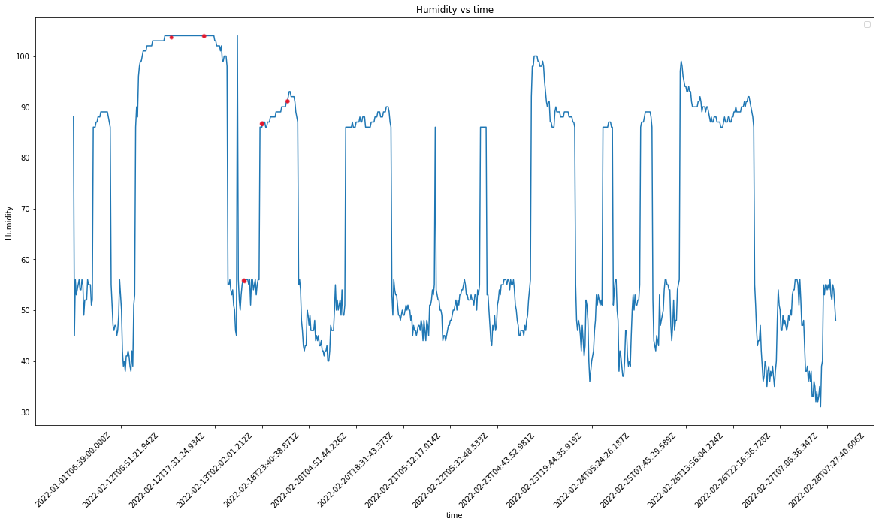
Variation Analysis

Slide 6
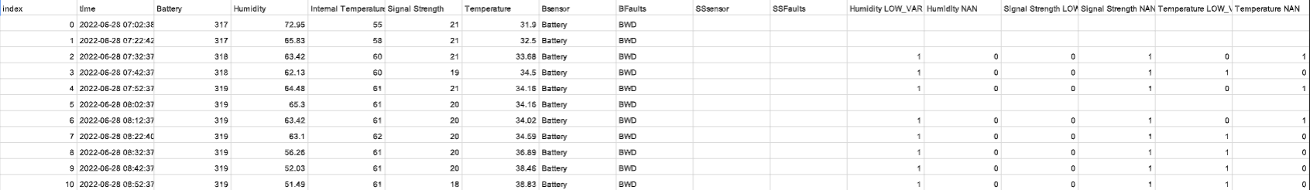
For single device

Slide 7
Sprint plan
Develop a rule based algorithm to classify fault categories by discussing with the embedded team.
Identified faults (No data at all, Wrong Data, High Variation,Low Variation, Same Variation data points)
Get the possible fault labels by grouping them together and finding any pattern

Slide 8
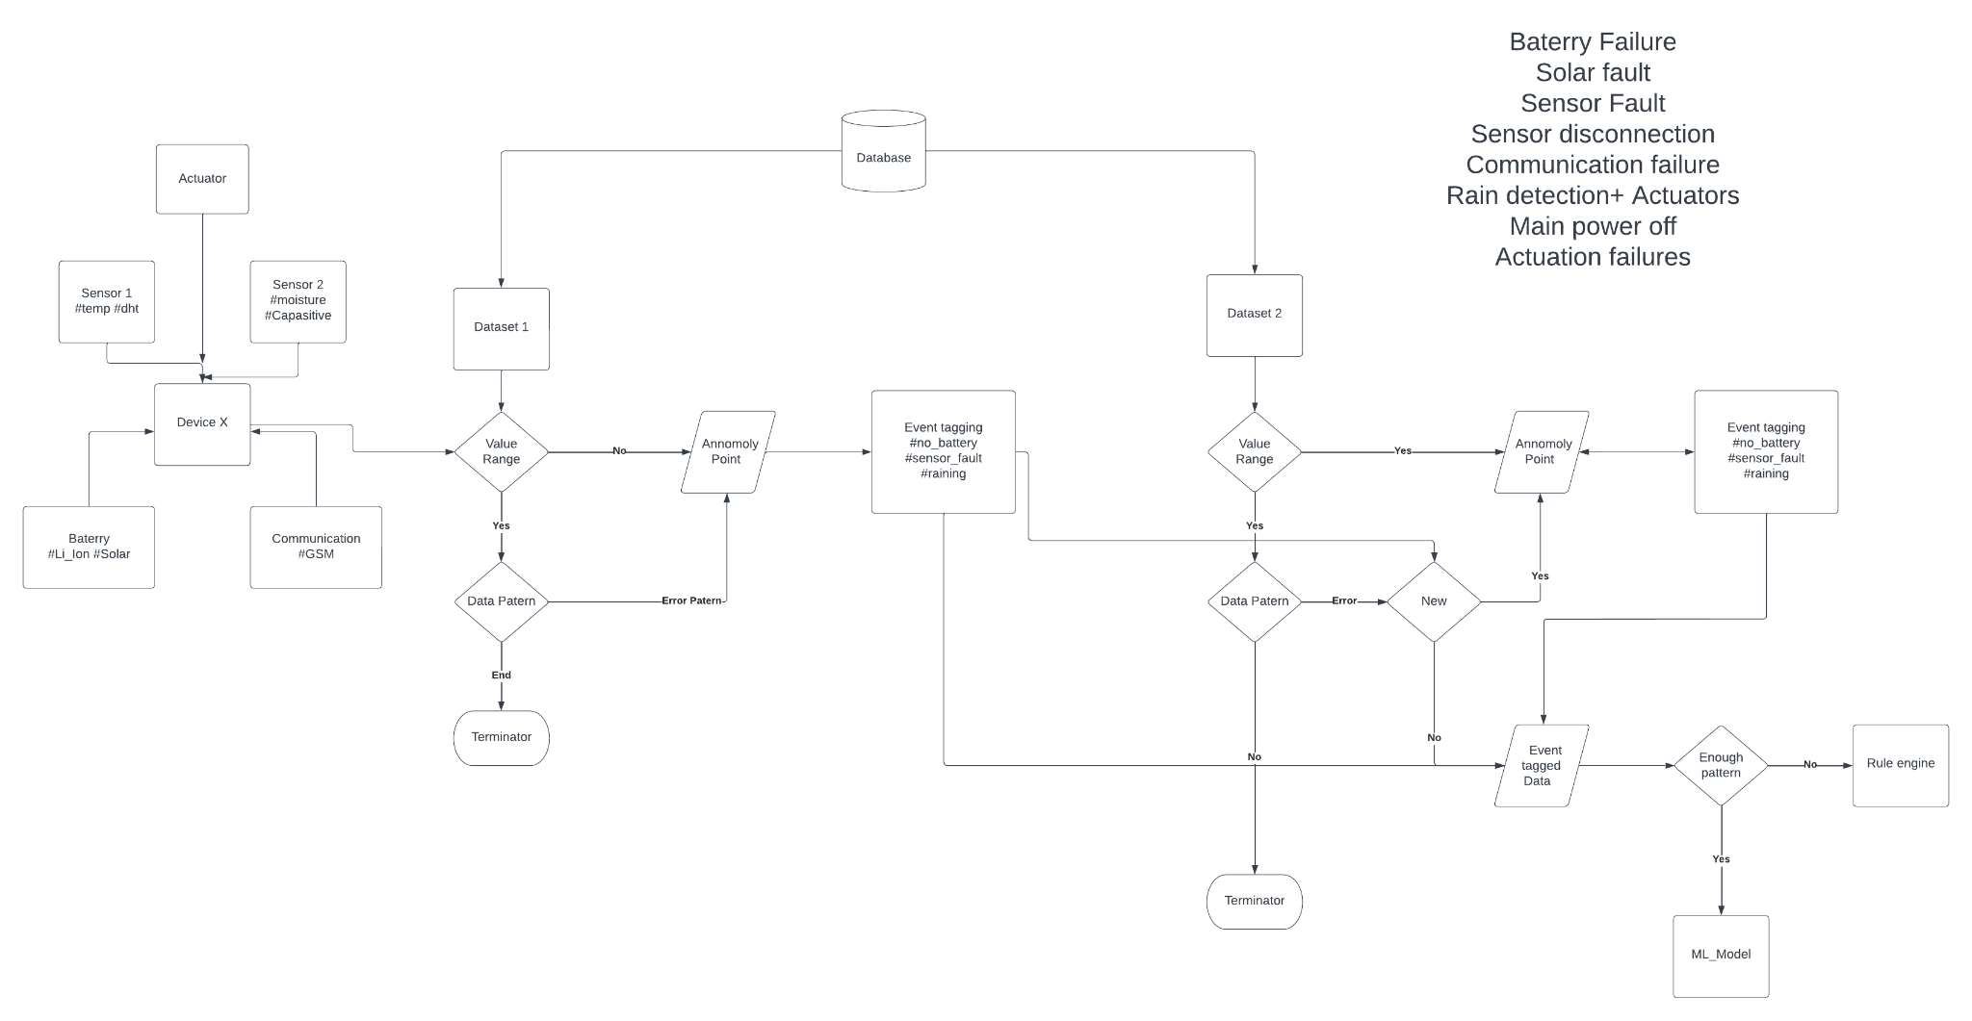

Slide 9
Build a fault classifier model and perform fault classification.
Perform root cause classification with different classifiers and analyse them. (ex.SVM, Decision Tree, Random Forest, Ensemble)

Slide 10
THANK YOU

